Slide 1

Oracle 11g: SQL
Chapter 5
Data Manipulation and Transaction Control

Slide 2
Objectives
Use the INSERT command to add rows to a table
Manage virtual columns in data manipulations
Use quotes in data values
Use a subquery to copy records from an existing table
Use the UPDATE command to modify the existing rows of a table
Use substitution variables with an UPDATE command
Oracle 11g: SQL

Slide 3
Objectives (continued)
Delete rows from a table
Manage transactions with transaction control commands COMMIT, ROLLBACK, and SAVEPOINT
Differentiate between a shared lock and an exclusive lock
Use the SELECT…FOR UPDATE command to create a shared lock
Oracle 11g: SQL

Slide 4
INSERT Command
Used to add rows to existing tables
Can only add one row at a time to one table
Identify the table in the INSERT INTO clause
Specify data in the VALUES clause
  Enclose nonnumeric data in single quotes
  If a column list is not provided, a value must be assigned to each column in the table in order
Oracle 11g: SQL

Slide 5
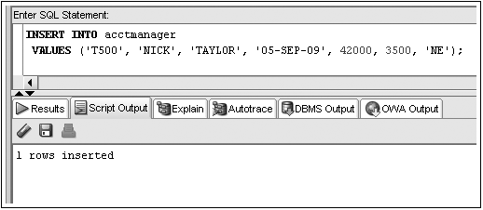
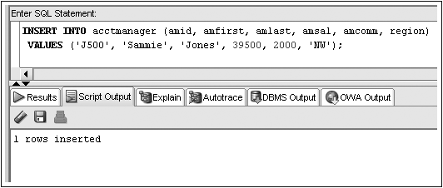
INSERT Command Examples
No Column List
Column List
Oracle 11g: SQL

Slide 6
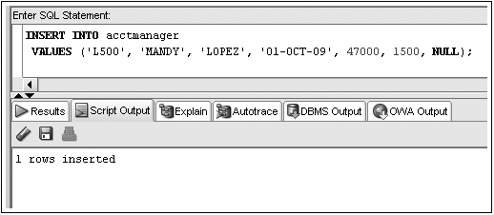
Inserting NULL Value
Omit column name from INSERT INTO clause column list
Substitute two single quotation marks or use NULL keyword
NULL value input
Oracle 11g: SQL

Slide 7
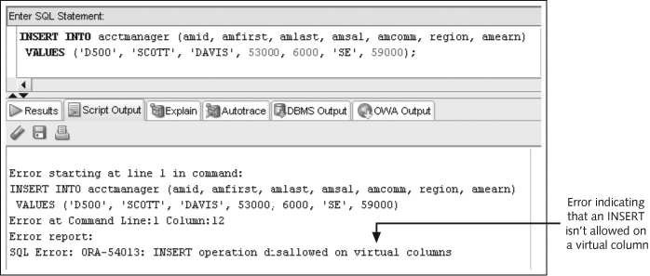
Manage Virtual Column Input
Oracle 11g: SQL

Slide 8
Constraint Violations
When you add or modify table data, the data is checked for compliance with any applicable constraints
Oracle 11g: SQL

Slide 9
Activating the DEFAULT option
Include a column list in the INSERT statement without the column to use the DEFAULT option
Use the DEFAULT keyword as the value for the column
Oracle 11g: SQL

Slide 10
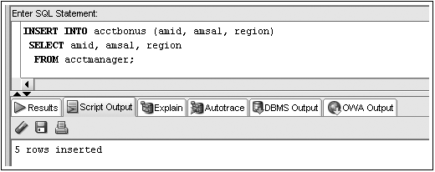
Inserting Data from an Existing Table
Substitute subquery for VALUES clause
Subquery
Oracle 11g: SQL

Slide 11
Modifying Existing Rows
Use UPDATE command to:
  Add values to an existing row by replacing NULL values
  Change existing values
Oracle 11g: SQL

Slide 12

UPDATE Command
UPDATE clause identifies table
SET clause identifies column(s) being changed and the new value(s)
Optional WHERE clause specifies which row(s) to be changed
Oracle 11g: SQL
Notes:
– if WHERE omitted, all rows will be updated!

Slide 13
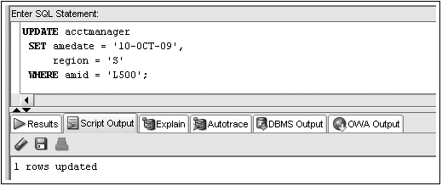
UPDATE Command Example
Oracle 11g: SQL

Slide 14
Substitution Variables
Prompts user for value
Identified by ampersand (&) preceding variable name
Can be used to create interactive scripts
Oracle 11g: SQL

Slide 15
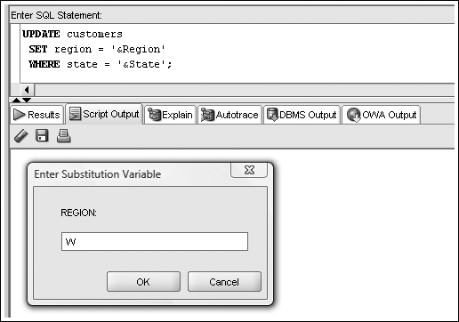
Substitution Variable Example
Oracle 11g: SQL

Slide 16
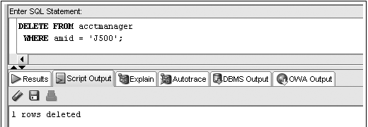
Deleting Rows
DELETE command removes rows from a table
WHERE clause determines which row(s) are removed
Omitting WHERE clause removes all rows
Oracle 11g: SQL

Slide 17
Transaction Control Statements
Results of data manipulation language (DML) are not permanently updated to a table until explicit or implicit COMMIT occurs
Transaction control statements can:
  Commit data through COMMIT command
  Undo data changes by ROLLBACK command
Oracle 11g: SQL

Slide 18
COMMIT Command
Explicit COMMIT occurs by executing COMMIT;
Implicit COMMIT occurs when DDL command is executed or user properly exits system
Permanently updates table(s) and allows other users to view changes
Oracle 11g: SQL

Slide 19
ROLLBACK Command
Used to “undo” changes that have not been committed
Occurs when:
  ROLLBACK; is executed
  System restarts after a crash
SAVEPOINT marks a specific spot within the transaction
Can ROLLBACK to a SAVEPOINT to undo part of the transaction
Oracle 11g: SQL

Slide 20
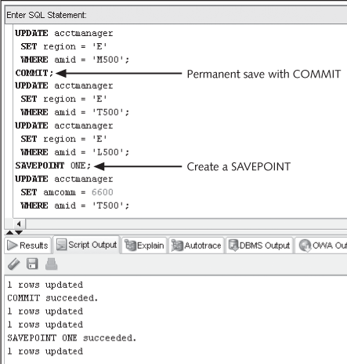
Transaction Control Example

Slide 21
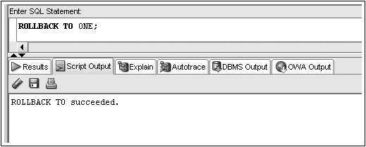
Transaction Control Example (continued)
Oracle 11g: SQL

Slide 22
Table Locks
Prevent users from changing same data or objects at the same time
Shared
  prevents DML operations on a portion of table
Exclusive
  locks whole table preventing other exclusive or shared locks
Oracle 11g: SQL

Slide 23
LOCK TABLE Command Shared Lock
Locks portion of table affected by DML operation
Implicitly occurs during UPDATE or DELETE operations
Explicitly occurs through LOCK TABLE command with SHARE MODE option
Released when COMMIT (implicit or explicit) or ROLLBACK occurs
Oracle 11g: SQL

Slide 24
LOCK TABLE Command Exclusive Lock
Implicitly locks table for DDL operations
– CREATE or ALTER TABLE
Explicitly locked through LOCK TABLE command with EXCLUSIVE MODE option
Released after execution of DDL operation or after user exits system
Oracle 11g: SQL

Slide 25

SELECT…FOR UPDATE Command
Creates shared lock on retrieved portion of table
Prevents one user from changing a row while another user is selecting rows to be changed
Released through implicit or explicit commit
Oracle 11g: SQL

